Slide 1
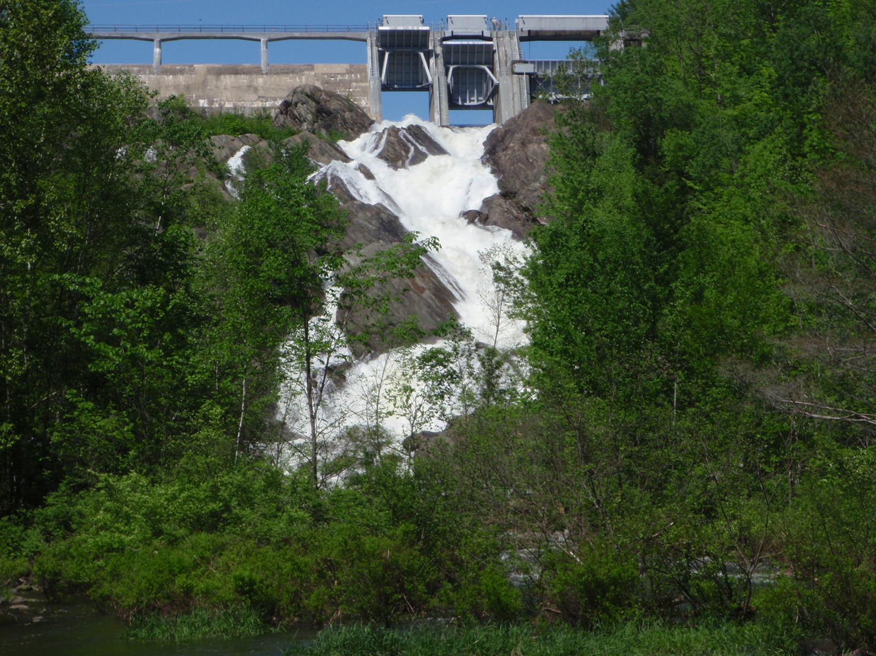
Department of Environmental Conservation - Dam Safety Program
Dam Safety Rules
Waterbury Dam
Windham County Natural Resources Conservation District WEBINAR
October 6, 2020
Ben Green, PE
Dam Safety Engineer
VTDEC Dam Safety Program

Slide 2
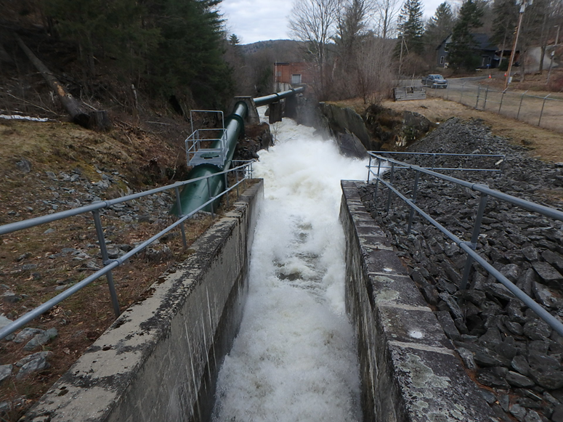
Presentation Overview
Introduction and Thanks
  Cory Ross -WCNRCD & Marie Caduto -VTDEC Watershed Planner
Agenda
  Background and How Dam Safety Rulemaking came to be in Vermont
  Dam Owner Obligation/Responsibility
  Recording Dams in Land Records
  Annual Fees
  Hazard Potential Classifications
  Inspection Schedule and Compliance
  Emergency Actions
Phase II – Dam Safety Standards Rulemaking
Available Resources and Future Training
Questions
Wrightsville Dam

Slide 3
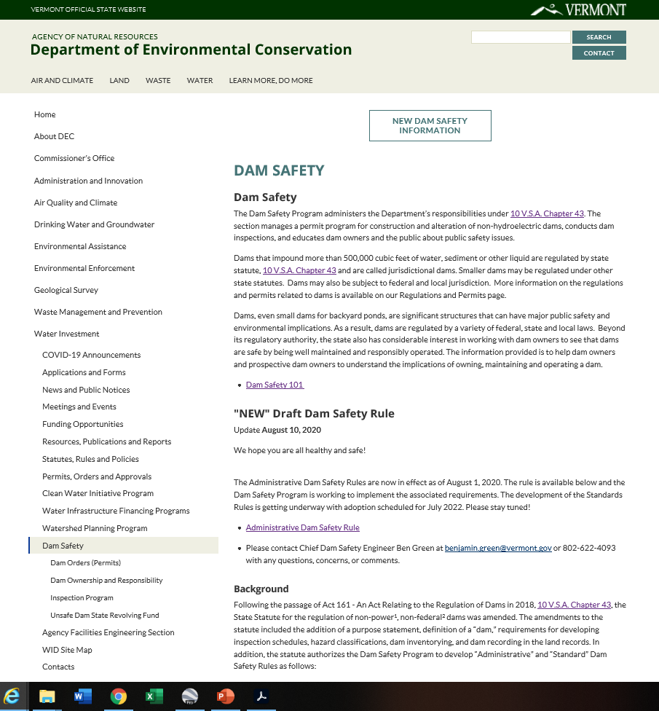
https://dec.vermont.gov/water-investment/dam-safety
LINK: 10 VSA Chapter 43 Dams Statute
LINK: Administrative Dam Safety Rule

Slide 4
Brief History of U.S. Dam Safety
2020 - Today
1889 – Failure South Forks Dam in PA
1972 – National Dam Inspection Act
1975 – National Dam Inventory
1979 –Federal Dam Safety Guidelines
1985 –ASDSO
1996 – National Dam
Safety Program
1982 –State Gov’s urged enact dam safety leg & allocate resources to dam safety
*Many strides in dam safety made after dam failures or incidents such as (to name a few):
Mill River Dam (1874) in MA = 139 deaths | St. Francis Dam (1928) in CA = 432 deaths
Buffalo Creek (1972) in WV = 125 deaths | Canyon Lake Dam (1972) in SD = 238 deaths
Teton Dam (1976) in ID = 11 deaths | Kelly Barnes Dam (1977) in GA = 39 deaths
Lawn Lake Dam (1982) in CO = 3 deaths | Meadow Pond Dam (1996) in NH = 1 death
Spencer Dam (2019) in NE = 1 death | Sanford Dam & Edenville Dams (2020) in MI = no deaths

Slide 5
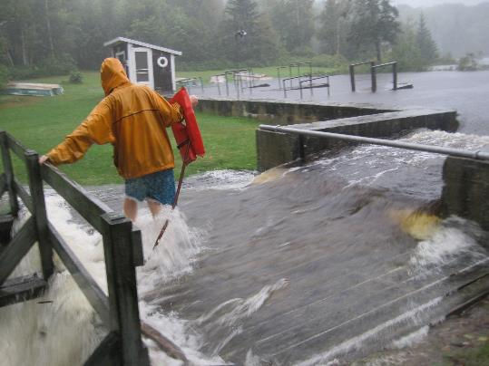
Brief History of Vermont Dams and Dam Safety
2020- Admin Rules
2022- Standard Rules
1852 – Failure of Dam in Bennington
1930s – Winooski River Flood Dams Built
1950s+60s – CT River Flood Dams Built
1923 – Harriman Dam Built
1981– Chapter 43: Dams Enacted
1927 Flood – Numerous Dams Failed
1947 – East Pittsford Dam Failed
2011 TS Irene– Some Small Dams Failed
2018 – Act 161 Passed, dam safety rule making authority
Noyes Dam during TS Irene

Slide 6

Regulation of Dams in Vermont
Dams in Vermont regulated by one of four agencies:
  Department of Environmental Conservation (DEC) = Non-hydropower, non-federal dams at the State Level
  Public Utility Commission (PUC) = Hydropower Dams Constructed pre- 1935 at the State Level
  Federal Energy Regulatory Commission (FERC) = Hydropower Dams Constructed post 1935 at the Federal Level
  United States Army Corps of Engineers (USACE) =
  Dams owned by the Corps or other Federal Entity

Slide 7
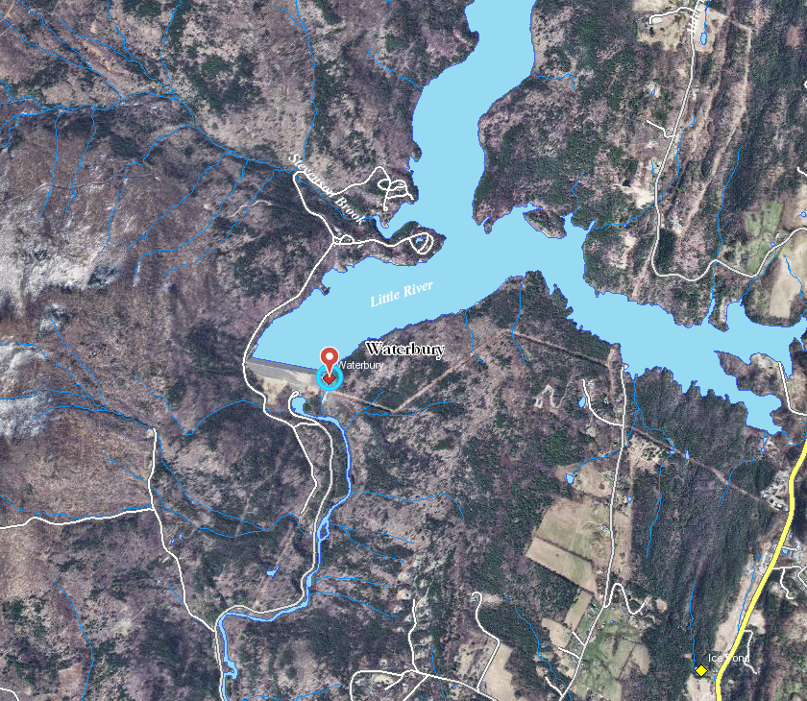
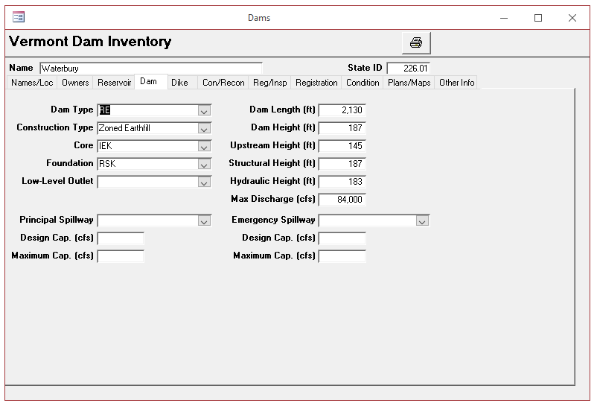
Vermont Dam Inventory (VDI)/Natural Resources Atlas
ANR Atlas
  https://anr.vermont.gov/maps/nr-atlas
  Rivers → Dams layer
  Right click on diamond to bring up attributes
Contains ~1,100 records (active and historic sites)
~413 under full jurisdiction of VTDEC(>500,000 cf)
41 HIGH, 110 SIGNIFICANT, 262 LOW
~570 dams under partial DEC Jurisdiction (<500,000 cf)
1 HIGH, 11 SIGNIFICANT, others LOW or not rated
~100 PUC / FERC
25 HIGH, 13 SIGNIFICANT, 62 LOW
15 other dams are under jurisdiction of
Federal Government, including 3 HIGH

Slide 8
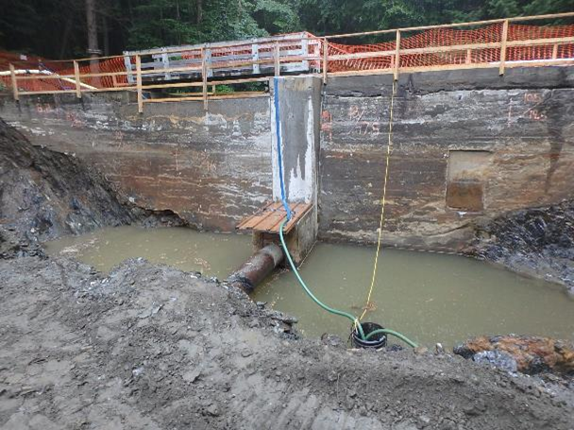
DEC Dam Safety Program Overview
Located in the Water Investment Division (WID) in VTDEC
Full time staff of two engineers
Mission different than most divisions in ANR/DEC. Primary focus is Public Safety.
Administer 10 V.S.A Chapter 43: Dams
  Non-federal, non-power dams
Act as Dam owners, regulators, and engineers
Inspections, Registration, Permitting, Inventory,
Unsafe Dam Proceedings, Operation and Maintenance
of 14 State Owned Dams
Sweet Pond Dam Rehabilitation, Guilford, 2018

Slide 9

Chapter 43: Dams
Legislation that guides regulation of dams at the State level (DEC and PUC)
Main Takeaways:
  Basic Definitions
  Jurisdiction between DEC and PUC
  Authorization/Permits/Application for dams that impound more than 500,000 cubic feet (about 11.5 acre-feet)
  Public Good Criteria
  Dam Inspections
  Unsafe Dams
Recently underwent updates in the 2018 session as Act 161

Slide 10
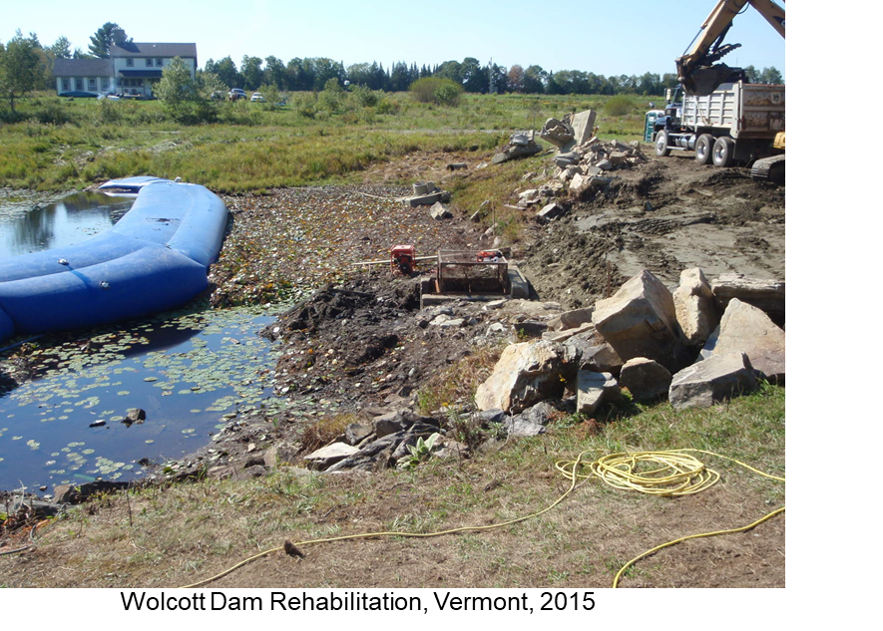
How Dam Safety Rulemaking Came to Pass In Vermont
Pre-existing Law (Chapter 43)
  Limited authorities
  No Dam Safety Rules
  Failed to meet National Dam Safety Standards
Dam Safety in VT lagging behind surrounding States
Aging Dam Inventory – Increasing number of dams with no public use/benefit
Increasing risks of a dam incident or failure
Rules developed with assistance of Interest Group
Presented in 2019 Dam Safety Workshop before formal rulemaking

Slide 11

Chapter 43: Dams, What’s changed?
Added purpose statement (protect public safety, provide public good)
Definition of a “Dam”
Non-Federal, non-power dams to be inspected according to a schedule.
Assess Hazard Classification of dams (High, Significant, Low, Minimal)
Dam Inventory be developed, updated and published on ANR Atlas
Dam owners will be required to register dams in land records
Person owning legal title/owner of land on which the dam is located
Rulemaking (Administrative and Standards)

Slide 12
Act 161
§1110 Rulemaking
  Phase I: Rules adopted August 2020
  Administrative Rules, including:
    Exemptions from Registration and Inspections
    Process for Owner Registration and dams recorded in Land records
    Hazard Classifications
    Inspection Schedule
  Phase II: Rules to be adopted by July 1, 2022
    Design Standards, including:
      Siting, design, construction, alteration
      Operation & Maintenance
      Inspection, monitoring, record keeping, reporting
      Repair, breach or removal
      Application for authorization under 1082
      Emergency Action Plans requirements and guidance

Slide 13
Proposed Rulemaking Schedule
Current, Fall 2020

Slide 14
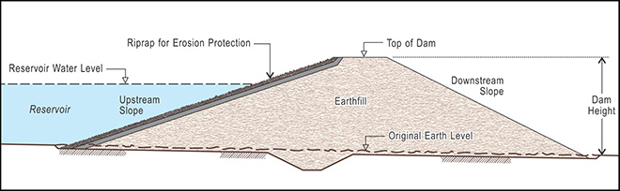
Administrative Rules
  Definitions:
“Dam” means any artificial barrier, including its appurtenant works, that is capable of impounding water, other liquids, or accumulated sediments.
A “Dam” includes an artificial barrier that meets all the following:
  previously was capable of impounding water, other liquids, or accumulated sediments;
  was partially breached; and
  has not been properly removed or mitigated.

Slide 15
Administrative Rules
  Definitions Continued:
A “Dam” shall not mean:
  barriers or structures created by beaver or any other wild animal.
  transportation infrastructure that has no normal water storage capacity and that impounds water only during storm events;
  an artificial barrier at a stormwater management structure that is regulated by the ANR under chapter 47;
  an underground or elevated tank to store water otherwise regulated by the ANR or an agricultural waste storage facility regulated by the Agency of Agriculture, Food and Markets under 6 V.S.A. chapter 215;
  Above or below grade tanks, vessels, storage chambers of steel/concrete construction used to store wastewater;
  Dug ponds created by excavating below grade and constructed without artificial barriers or outlet structures, which pose no threat to life, property, lifelines, or the environment downstream;
  any structure related to a wastewater treatment facility permitted by the Agency pursuant to 10 V.S.A. § 1263, excluding wastewater ponds and lagoons.
  Levees, meaning any earthen embankment, floodwall, or structure along a water course whose purpose is flood risk reduction or water conveyance.

Slide 16
Administrative Rules
  Applicability → WHAT DAMS DOES THIS APPLY TO?:
  All non-power, non-federal dams in the State
  What’s out??
    power dams, federally owned dams, dams regulated by the PUC
  Those items listed under, “A dam shall not mean”
  Dams that impound less than 500,000 cf are INCLUDED:
    An Order through Dam Safety Program not required to construct, alter, or remove (other State and Federal Permits may apply)
    Currently, no Annual Registration Fee
    All other requirements in Rule apply (i.e. Recording in Land Records, Inspections, Compliance with Inspection Results, Standards once developed)

Slide 17
Administrative Rules
  Dam Owner Obligation and Responsibility under Rule:
  Safe management and operation of their dam
  The significant financial undertaking required of dam ownership.
  Cooperation with the Department and compliance with this Rule.
  Rule Compliance does not relieve dam owner/operator from liability as a result of dam failure or mis-operation for injury to persons, including loss of life or damage to property of others.

Slide 18
Administrative Rules
  Dam Recording in the Land Records:
Purpose:
  inform present and future property owners of the dam on the property and legal responsibilities associated with dam ownership.
Process:
  Applies to dams subject to this rule in the Vermont Dam Inventory
  Required at the Request of Department
  Within 60 days of request, complete Dam Record Form and return to Department.
  Multiple Owners = One Dam Record Form per Owner
  Dam Record Certificate then issued to Owner
  Owner has 30 days to file in land records and 30 days to provide proof to Department
  Dam in Multiple Towns = Dam Record Form in Each Town
  Transfers: Owner shall notify Department of pending transfer. Within 30 days of transfer, new owner shall inform Department, new Dam Record Certification issued

Slide 19
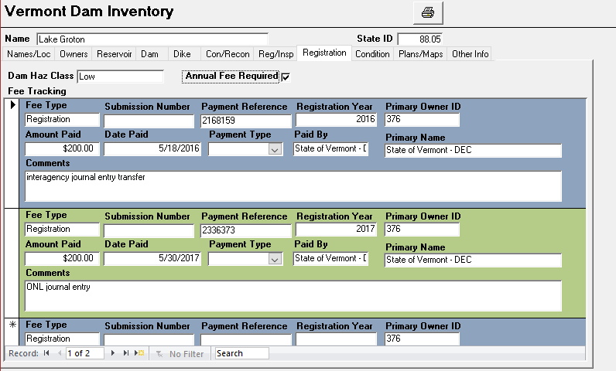
Administrative Rules
Annual Dam Registration
Enacted in 2016, current rulemaking clarified process
Annual fee for Owners of Dams capable of impounding >500,000 cubic feet
  HIGH hazard Dams = $1,000
  SIGNIFICANT hazard Dams = $350
  LOW Hazard Dams = $200
Fees help fund Dam Safety Program
Fee collection allows for regular owner outreach

Slide 20
Administrative Rules
  Hazard Classifications:
  “Hazard Potential” potential for adverse incremental consequences that could result from dam failure or mis-operation
  Hazard potential classification based on potential loss of life, damage to property, lifelines, and the environment from dam failure,
  Unrelated to Dam Condition
  Hazard Classification for:
    identifying potential risks to public safety,
    establishing inspection schedules, and
    assuring adherence to design criteria.
  Hazard classification determined by Department and noted in the Dam Inventory.
  Periodically necessary to reclassify dams/evaluate hazard creep

Slide 21
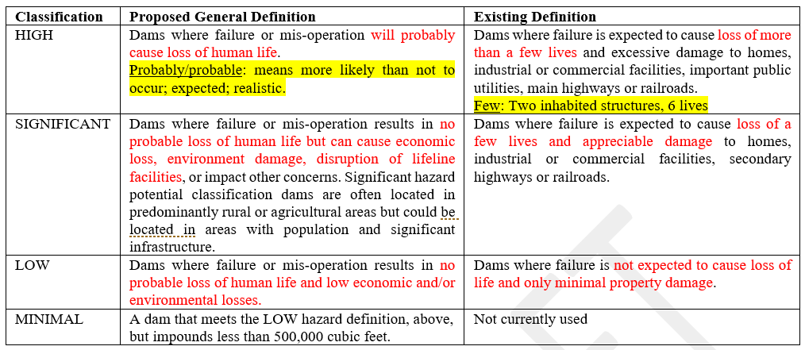
Administrative Rules
  Hazard Classifications, Continued:
Classification
Adopted Definition
Pre-Existing Definition

Slide 22
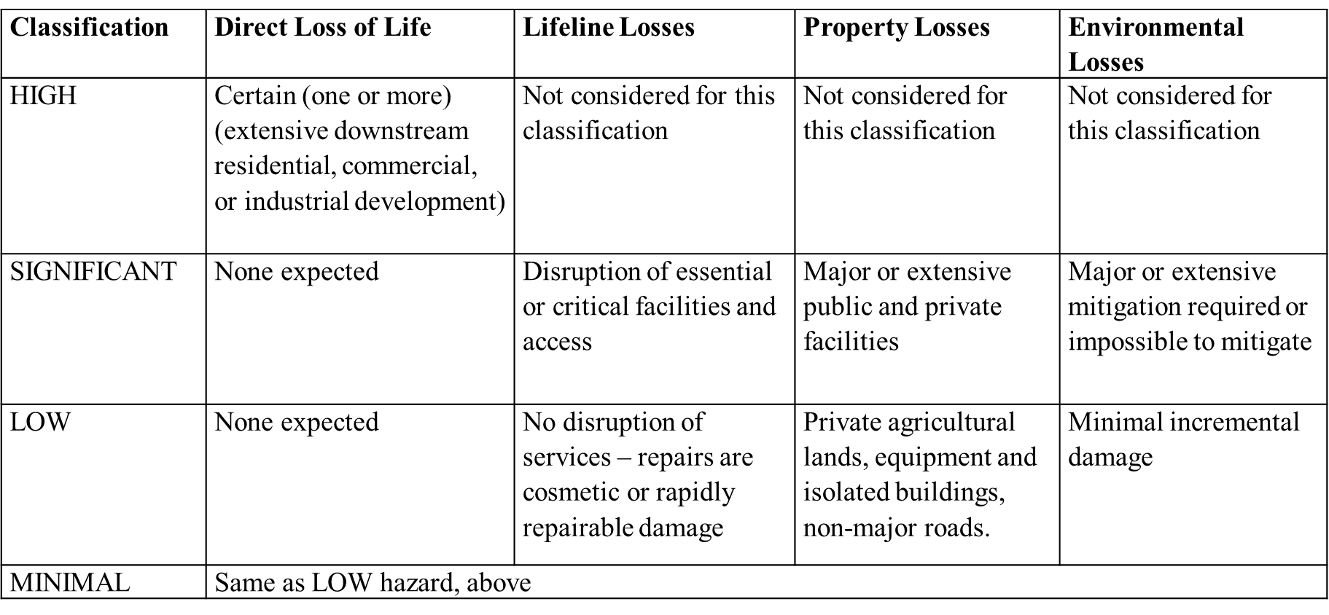
Administrative Rules
  Hazard Classifications, Continued:

Slide 23
Administrative Rules
  Inspection Schedule:
Dam inspections shall be performed under the supervision of an Engineer. Inspections shall be performed in compliance with Department requirements by the Department or an Engineer hired by the Owner.
Inspection Types:
  Periodic: Visual by Department or Engineer hired by the Owner at the frequency described in the table below. If Department unable to perform inspection, shall give Owner 6 months notice to hire an Engineer and complete inspection.
    First inspection shall be performed when initiated/required by Department.
    Subsequent inspections shall be performed in compliance with table above.
Periodic Inspections
Hazard Classification | Frequency
HIGH | 2 years
SIGNIFICANT | 5 years
LOW | 10 years
MINIMAL | None

Slide 24
Administrative Rules
  Inspection Schedule Continued:
Inspection Types Continued:
  Non-Periodic: Inspections performed outside of specified Periodic Inspection interval.
    may occur at the request of Owner or Individual,
    may occur following changes in conditions/application of new/different loading conditions.
  Inventory: Inspection to document configuration of dam for Dam Inventory.
  Construction: Inspection during construction to observe progress/assess compliance with plans, specifications, Order.
  Comprehensive: Detailed inspection including studies, investigations, and analyses required to evaluate project risk and safety. Required on 10-year basis for HIGH hazard dams and 15- year basis for SIGNIFICANT hazard dams.

Slide 25
Administrative Rules
  Inspection Schedule Continued:
Individual Inspection Request: An interested person may request Department perform inspection in writing, must provide:
  Location
  Owner contract information
  Statement explaining why dam should be inspected
The Department shall review request, determine if inspection is required, and proceed accordingly.
Department Permission for Entry for Inspections: Owners shall allow Department access at reasonable times. If owner does not permit access, Department may apply for access order.

Slide 26
Administrative Rules
  Compliance with Inspection Results:
If, based on inspection, Department determines maintenance, investigation and analysis, or repairs or reconstruction to a dam are needed to maintain dam in safe condition, Department shall notify Owner in writing and require work undertaken within the time period specified.
If Owner does not strive to undertake required work, Department may bring enforcement and or require Owner to drain reservoir and maintain it drained until necessary work has been completed.
Source: FEMA P-911

Slide 27
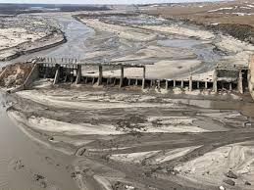
Administrative Rules
  Emergency Action:
Dam owners have primary responsibility for determining
when an emergency involving their dam exists.
Owner shall immediately implement Emergency Action Plan (if applicable),
and take necessary actions to safeguard life, property, lifelines, and environment.
If necessary action not being taken by Owner, Department has authority to take action if not sufficient time for enforcement.
Department shall maintain full control over dam until it is rendered safe or the emergency has ceased.
Departments’ “take-over” of dam shall not relieve Owner’s legal liability.
Departments’ assumption of control over dam shall not constitute a taking and Department shall not be liable for diminution in property value.
Department may choose to recover costs of actions from Owner.
Spencer Dam, NE

Slide 28
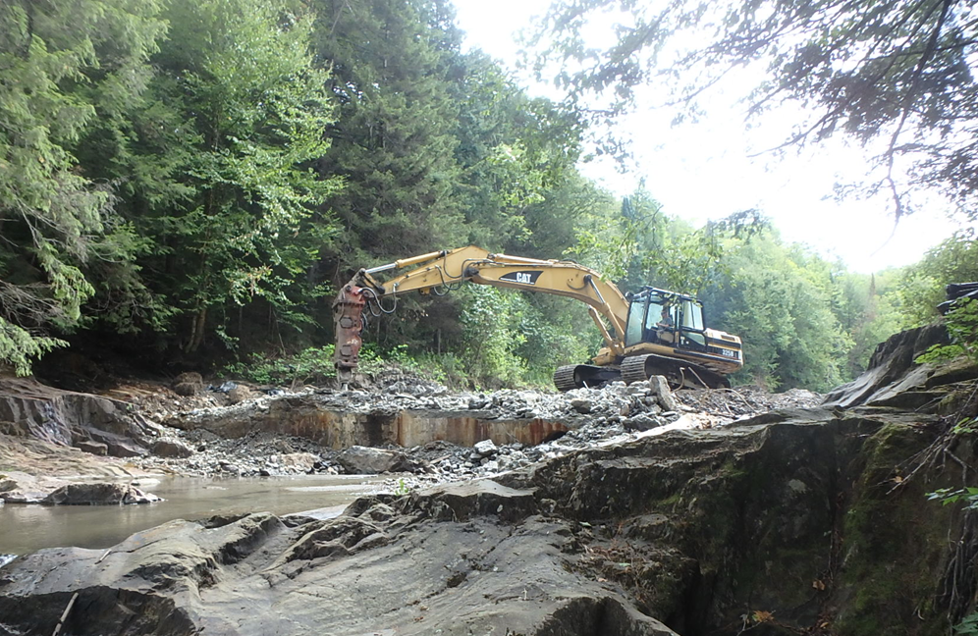
Upcoming Standards Rules
  Anticipated Topics:
Standards Based Approach and/versus Risk Informed Decision Making
New Dam and Existing Dam Rehabilitation Design Requirements
  Hydrology and Hydraulics
  Geology, Geotechnical, and Seismic
  Structural
Dam breach and Removal Requirements
Dam Order Application Requirements
Operation and Maintenance Manuals
Dam Inspection Requirements
Emergency Action Plan requirements (HIGH and SIGNIFICANT Hazard Dams)
Camp Wihakowi Dam Removal, Northfield, 2020

Slide 29
Resources and Future Training
  Future State Informational Meetings and Training:
    Dam Safety Workshop for Standards Rules
    Standards Rulemaking Hearings
    Upcoming Subject Matter Workshops
  VTDEC Dam Safety Website (or contact us): https://dec.vermont.gov/water-investment/dam-safety
  Association of State Dam Safety Officials: https://damsafety.org/
  Federal Dam Safety Guidance Documents:
    FEMA: https://www.fema.gov/emergency-managers/risk-management/dam-safety
    USACE: https://www.usace.army.mil/Missions/Civil-Works/Dam-Safety-Program/
    USBR: https://www.usbr.gov/ssle/damsafety/index.html
  Dam Removal – State and Federal: VT Dam Task Force, VNRC, CT River Conservancy, US Fish & Wildlife, EPA, VT F&W, TNC, TU, VRC

Slide 30

Thank you!
Questions?
Ben Green, PE
Dam Safety Engineer
VTDEC Dam Safety Program
802-622-4093
Benjamin.Green@vermont.gov
Wrightsville Reservoir

